Slide 1
Project SIRE504
Group 3
Sorawan Tiratrakoonwichaya 6737929
Chutiwan Pankram 6737933
Phanisa Butsiri 6737935

Slide 2


Plan A (27/09/67)
Program
main.py + magic file
argparserLocal, main, read fastq file (open zipfile)
Read Statistic Function
Read Filtering Function
Read length, q_score, barcode, min, max, N50, Median,
create new zipfile, filter
Ize
Ant
Fern
Plan A
Deadline Project: 18 Nov
Deadline Slide Powerpoint: 25 Nov
Present project: 4 December !!!

Slide 3
Plan A+1 (4/10/67)
Plan A+1
group_project
: There are 4 files in this program.
fastq
: magic file for the program used in command line
main.py
: include main code for running the program.
q_stat.py
: calculate the quality score and other statistics.
filter.py
: filter reads based on calculations from q_stat.py.

Slide 4
Plan A+1 (4/10/67)
Fern
Plan A+1
main.py
: main code for running the program
main()
: for running the program
argparserLocal()
: for handling command-line arguments.
get_data()
: for reading the FASTQ file.
option_barcode()
: for grouping the reads by barcode.
table()
: display statistics outcomes in a table format.

Slide 5
Plan A+1 (4/10/67)
Ant
Plan A+1
q_stat.py
: calculate the quality score and other statistics.
qscore()
: Calculate the quality score of each read.
Max & Min
: Find max and min quality of reads.
Reads length
: Count the number of base in reads.
Mean & SD
: Calculate mean of quality score of each read.
Med & N50 &IQR
: Calculate median, N50, and IQR of each read.
Need to install numpy package to use this function.

Slide 6
Plan A+1 (4/10/67)
Ize
Plan A+1
filter.py
: filter reads based on calculation.
filter()
: use the statistics generated to define filtering threshold (e.g. quality score, read length).
new_zipfile()
: create a new FASTQ file in zip file with filtered reads.

Slide 7
Design program
Write code
Combine & check code
Plan A+2
Plan A+2
Fern
Fern
main.py
fastq
Deadline: 23 Oct
Ant
q_stat.py
Ize
filter.py
Deadline: 18 Nov

Slide 8
(23/10/67)
Design program
Plan A+2
Program Features
calQ
: Calculate a mean of quality score for each read.
len
: Calculate length for each read.
Qsum
: Calculate mean of quality score and length for each read.
filter
: Filter each read.
newFASTQ
: Create a new FASTQ file with filtered reads.

Slide 9
Design program
(Prototype)
Plan A+2
calQ
: Calculate a mean of quality score for each read.
$ ./fastq calQ -f data_test.fastq
read id | barcode | Q score | SD
1 | 1 | 10 | X
2 | 1 | 20 | X
3 | 2 | 30 | x
$ ./fastq calQ -f data_test.fastq -b
barcode | Number of reads | mean Q score | SD | min score | max score
1 | 2 | 15 | X | 10 | 20
2 | 1 | 30 | x | 30 | 30

Slide 10
(Prototype)
Create output
Design program
(Prototype)
Plan A+2
calQ
: Calculate a mean of quality score for each read.
$ ./fastq calQ -f data_test.fastq -m
read id | barcode | median Q score | IQR
1 | 1 | 10 | X
2 | 1 | 20 | X
3 | 2 | 30 | x
$ ./fastq calQ -f data_test.fastq –b -m
barcode | Number of reads | median Q score | IQR | min score | max score
1 | 2 | 15 | X | 10 | 20
2 | 1 | 30 | x | 30 | 30

Slide 11
Design program
(Prototype)
Plan A+2
len
: Calculate length for each read.
$ ./fastq len -f data_test.fastq
read id | barcode | length
1 | 1 | 100
2 | 1 | 110
3 | 2 | 90
$ ./fastq len -f data_test.fastq –b
barcode | Number of reads | mean length | SD | min length | max length
1 | 2 | 105 | X | 100 | 110
2 | 1 | 90 | x | 90 | 90

Slide 12
Design program
(Prototype)
Plan A+2
len
: Calculate length for each read.
$ ./fastq len -f data_test.fastq –b -m
barcode | Number of reads | median length | IQR | min length | max length
1 | 2 | 105 | X | 100 | 110
2 | 1 | 90 | x | 90 | 90

Slide 13
Design program
(Prototype)
Plan A+2
Qsum
: Calculate mean of quality score and length for each read.
$ ./fastq Qsum -f data_test.fastq
read id | barcode | length | Q score | SD
1 | 1 | 100 | 10 | X
2 | 1 | 110 | 20 | X
3 | 2 | 90 | 30 | x
$ ./fastq Qsum -f data_test.fastq –b
barcode | Number of reads | mean length | SD | mean Q score | SD
1 | 2 | 105 | X | 15 | X
2 | 1 | 90 | x | 30 | x

Slide 14
Design program
(Prototype)
Plan A+2
Qsum
: Calculate mean of quality score and length for each read.
$ ./fastq Qsum -f data_test.fastq -m
read id | barcode | length | median Q score | IQR
1 | 1 | 100 | 10 | X
2 | 1 | 110 | 20 | X
3 | 2 | 90 | 30 | x
$ ./fastq Qsum -f data_test.fastq –b -m
barcode | Number of reads | median length | IQR | median Q score | IQR
1 | 2 | 105 | X | 15 | X
2 | 1 | 90 | x | 30 | x

Slide 15
Design program
(Prototype)
Plan A+2
filter
: Show filtering status for each read. Default: l = 100, q = 30
$ ./fastq filter -f data_test.fastq –l 100 –q 20
read id | barcode | length | Q score | status
1 | 1 | 100 | 10 | Not pass
2 | 1 | 110 | 20 | Pass
3 | 2 | 90 | 30 | Not pass
$ ./fastq filter -f data_test.fastq –l 100 –q 20 –b
barcode | Number of reads | status
1 | 2 | 50%
2 | 1 | 0%

Slide 16
Design program
(Prototype)
Plan A+2
filter
: Show filtering status for each read. Default: l = 100, q = 30
$ ./fastq filter -f data_test.fastq –l 100 –q 20 -m
read id | barcode | length | median Q score | status
1 | 1 | 100 | 10 | Not pass
2 | 1 | 110 | 20 | Pass
3 | 2 | 90 | 30 | Not pass
$ ./fastq filter -f data_test.fastq –l 100 –q 20 –b -m
barcode | Number of reads | status
1 | 2 | 50%
2 | 1 | 0%

Slide 17
Design program
(Prototype)
Plan A+2
newFASTQ
: Create a new FASTQ file with filtered reads.
Default: l = 100, q = 30, n = summary_data.fastq
$ ./fastq newFASTQ -f data_test.fastq –l 100 –q 20 –m –n test.fastq
Get a new FASTQ file named “test.fastq” with filtered reads.

Slide 18
Design program
Write code
Combine & check code
Plan A+2
Plan A+2
Fern
Fern
main.py
fastq
Deadline: 23 Oct
Ant
q_stat.py
Ize
filter.py
Deadline: 18 Nov

Slide 19
(Fern)
Write code
Plan A+2
old V.0
new v.1
main.py
: main code for running the program
main.py
main()
: main function for running the program
main()
read_zipfile()
argparserLocal()
: use for handling command-line argument.
argparserLocal()
read_file()
get_data()
: read the FASTQ file.
get_data()
line1()
option_barcode()
option_barcode()
line4()
: group the reads by barcode.
table()
table()
status_read()
: display statistics outcomes in a table format.
19

Slide 20
Write code
(Fern)
Plan A+2
old V.0
new v.1
new v.2
main.py
main.py
: main code for running the program
main()
main()
read_zipfile()
: read compressed FASTQ file by gzip.
: main function for running the program
argparserLocal()
argparserLocal()
read_file()
: read FASTQ file.
: use for handling command-line argument.
get_data()
get_data()
: select function to read file.
line1()
: collect barcode and ID.
: read the FASTQ file.
option_barcode()
option_barcode()
line4()
: select function from q_stat.py to work with line 4
: group the reads by barcode.
: collect data for each barcode.
table()
table()
status_read()
: display statistics outcomes in a table format.
: summary status of each read.

Slide 21
Write code
(Fern)
Plan A+2
old
new v.1
new v.2
main.py
main.py
: main code for running the program
main()
main()
read_zipfile()
: read compressed FASTQ file by gzip.
: main function for running the program
argparserLocal()
argparserLocal()
read_file()
: read FASTQ file.
: use for handling command-line argument.
get_data()
get_data()
: select function to read file.
line1()
: collect barcode and ID.
: read the FASTQ file.
Problem!!
option_barcode()
option_barcode()
- Contain duplicate commands code lengthy.
- Take a long time to process large files.
line4()
: select function from q_stat.py to work with line 4
: group the reads by barcode.
: collect data for each barcode.
table()
table()
status_read()
: display statistics outcomes in a table format.
: summary status of each read.

Slide 22
Write code
(Fern)
Plan A+2
new v.1
old
new v.2
main.py
main.py
: main code for running the program
main()
main()
read_zipfile()
: read compressed FASTQ file by gzip.
: main function for running the program
argparserLocal()
argparserLocal()
read_file()
: read FASTQ file.
: use for handling command-line argument.
get_data()
get_data()
: select function to read file.
line1()
: search barcode and ID.
: read the FASTQ file.
Problem!!
option_barcode()
- Contain duplicate commands code lengthy.
- Take a long time to process large files.
option_barcode()
line4()
: select function from q_stat.py to work with 4th line.
: group the reads by barcode.
: collect data for each barcode.
table()
table()
status_read()
: display statistics outcomes in a table format.
: summary status of each read.

Slide 23
(Ant)
Write code
Plan A+2
q_stat.py
: Calculation quality score sessions.
valueofquality()
: Calculate total quality score.
calmean()
: Calculate mean of quality score.
lenofreads()
: Count length of reads
SDquality()
: Calculate standard deviation of reads.
calquantile()
: Calculate median and quantile of reads.
Problem
Median (ant)
Filter (ice)
File name (ice)

Slide 24
(Ant)
Write code
Plan A+2
q_stat.py
: Calculation quality score sessions.
callenandbar()
: Calculate mean of Q, SD of each barcode.
Callenandbar_median()
: Calculate median and quantile of each barcode.

Slide 25
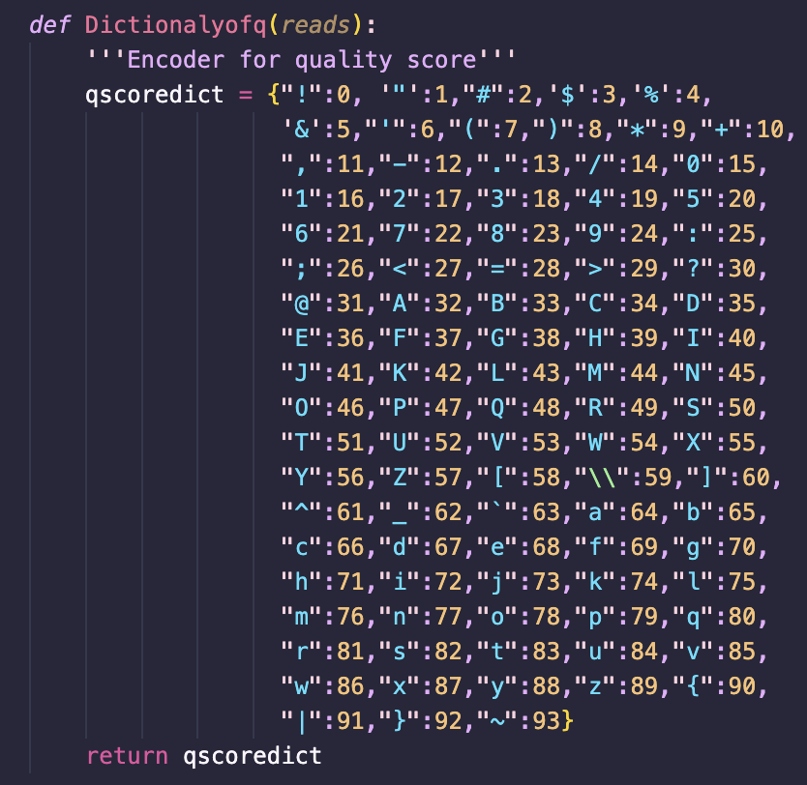
(Ant)
Write code
Plan A+2
q_stat.py
: calculate quality score from the reads.
Dictionalyofq()
: get each quality score.

Slide 26
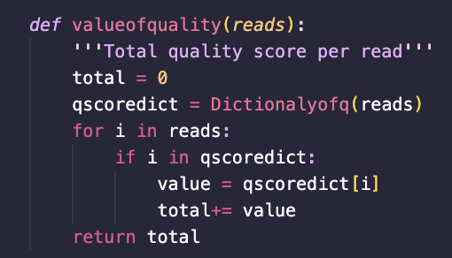
(Ant)
Write code
Plan A+2
q_stat.py
: calculate quality score from the reads.
valueofquality()
: Calculate total quality score.
Function: Calculate each reads by compare with ASCII score in dictionary, sum score and return total value.

Slide 27
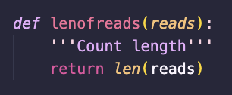
(Ant)
Write code
Plan A+2
q_stat.py
: calculate quality score from the reads.
lenofreads()
: Count length of reads.
Function: Count number of characters in each reads.

Slide 28
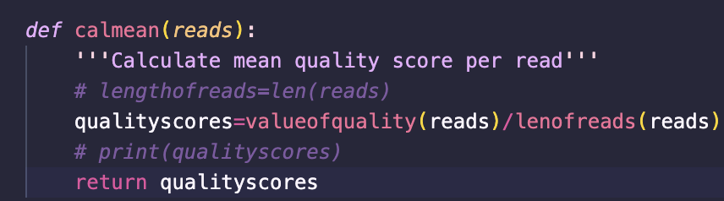
(Ant)
Write code
Plan A+2
q_stat.py
: calculate quality score from the reads.
calmean()
: Calculate mean of quality score.
Function: Calculate mean quality score for each read.

Slide 29
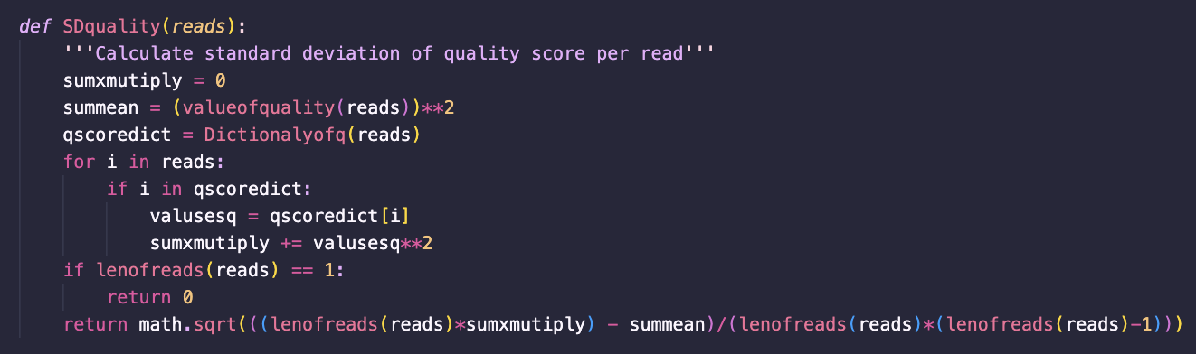
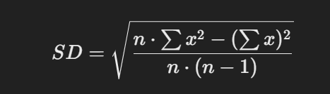
(Ant)
Write code
Plan A+2
q_stat.py
: calculate quality score from the reads.
SDquality()
: Calculate diviation of reads.
Function: Calculate SD by use this formula.

Slide 30
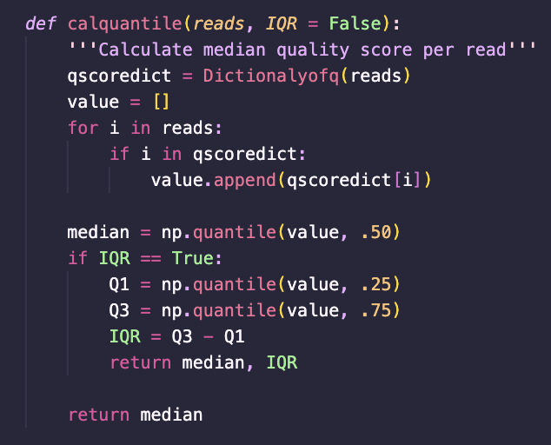
(Ant)
Write code
Plan A+2
q_stat.py
: calculate quality score from the reads.
calquantile()
: Calculate median and quantile values.
Function: Calculate quantile values by use numpy module to call quantile function.

Slide 31
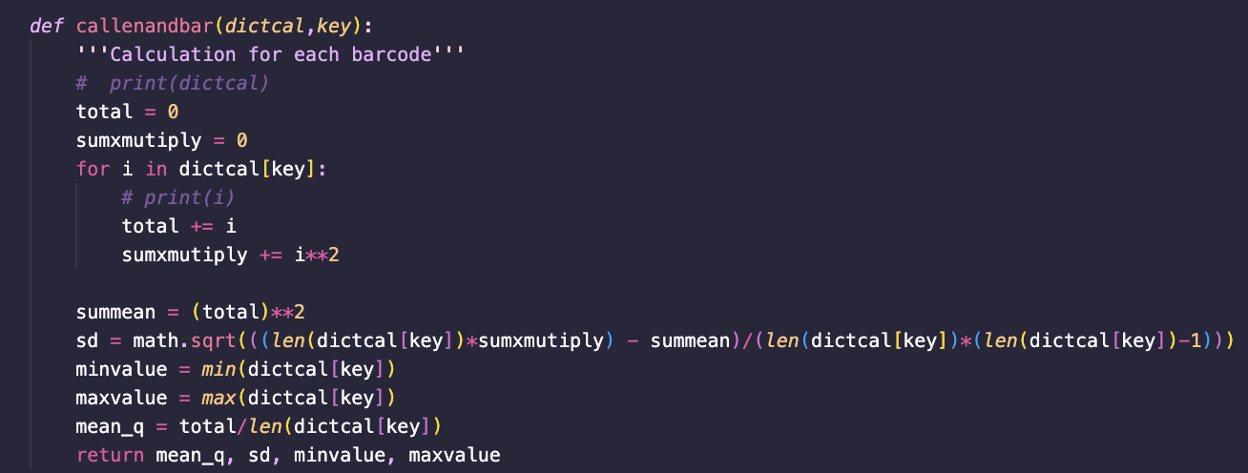
(Ant)
Write code
Plan A+2
q_stat.py
: calculate quality score from the reads.
callenandbar ()
: Calculate mean of Q, SD of each barcode.
Function: Calculate mean of quality by value from key in dictionary
Dictionary
{ l : [data], q : [data] }

Slide 32
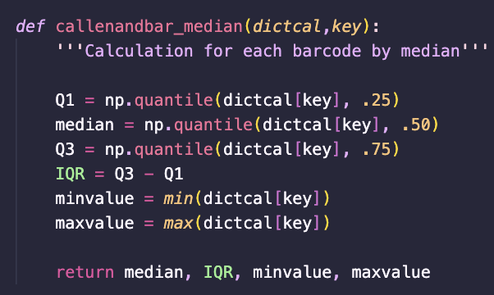
(Ant)
Write code
Plan A+2
q_stat.py
: calculate quality score from the reads.
callenandbar _median()
: Calculate median and quantile of each barcode.
Function: Calculate median of each barcode.

Slide 33
(Ize)
Write code
Plan A+2
filter.py
: filter reads based on calculations from q_stat.py.
filter_quality()
: Checks sequence quality scores.
filter_length()
: Verifies sequence lengths.
filter_bar()
: Summarizes filtering results by barcode.
write_file()
: Saves filtered reads into a new file.
name_file()
: Manages output filenames dynamically.
Problem
Median (ant)
Filter (ice)
File name (ice)

Slide 34
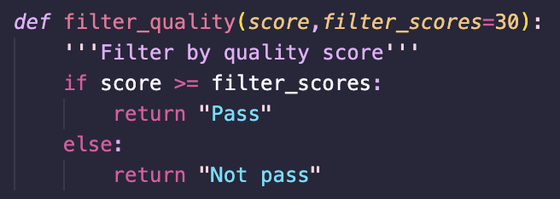
(Ize)
Write code
Plan A+2
filter.py
: filter reads based on calculations from q_stat.py.
filter_quality()
: Checks sequence quality scores.
Function: Determines whether a sequence passes the quality threshold.

Slide 35
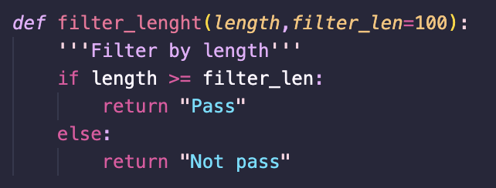
(Ize)
Write code
Plan A+2
filter.py
: filter reads based on calculations from q_stat.py.
filter_length()
: Verifies sequence lengths.
Function: Evaluates the sequence length against a predefined threshold.

Slide 36
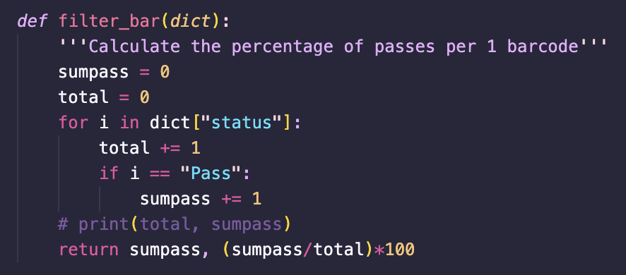
(Ize)
Write code
Plan A+2
filter.py
: filter reads based on calculations from q_stat.py.
filter_bar()
: Summarizes filtering results by barcode.
Function: Calculates the percentage of sequences that pass the filters for each barcode.

Slide 37
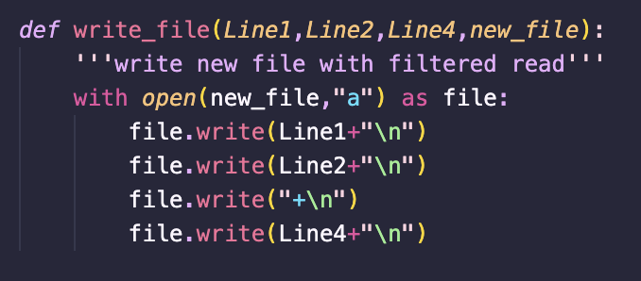
(Ize)
Write code
Plan A+2
filter.py
: filter reads based on calculations from q_stat.py.
write_file()
: Saves filtered reads into a new file.
Function: Writes filtered sequences to a new FASTQ file.

Slide 38
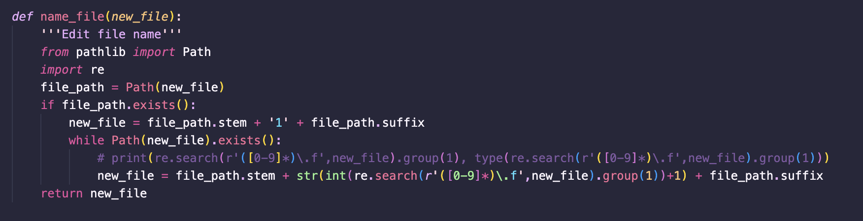
(Ize)
Write code
Plan A+2
filter.py
: filter reads based on calculations from q_stat.py.
name_file()
: Manages output filenames dynamically.
Function: Handles file naming to avoid overwriting existing files.

Slide 39
Combine & check code
Plan A+2
group_project
Let’s go to our program
fastq
fastq
main.py
q_stat.py
filter.py
https://github.com/Sorawan-Tiratrakoonwichaya/group_project/tree/main/code

Slide 40
Dictionary
{ Barcode1 : { Num of read : int, l : [int], q : [float], status : [string] }, Barcode2 : { Num of read : 0, l : [0], q : [0.00], status : [Pass] },
Barcode3 : { Num of read : 0, l : [0], q : [0.00], status : [Pass] } }

